Slide 1
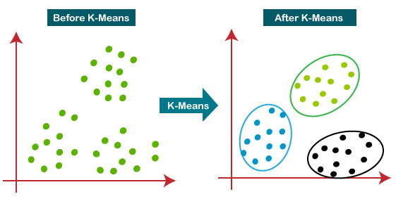
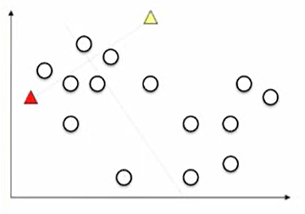
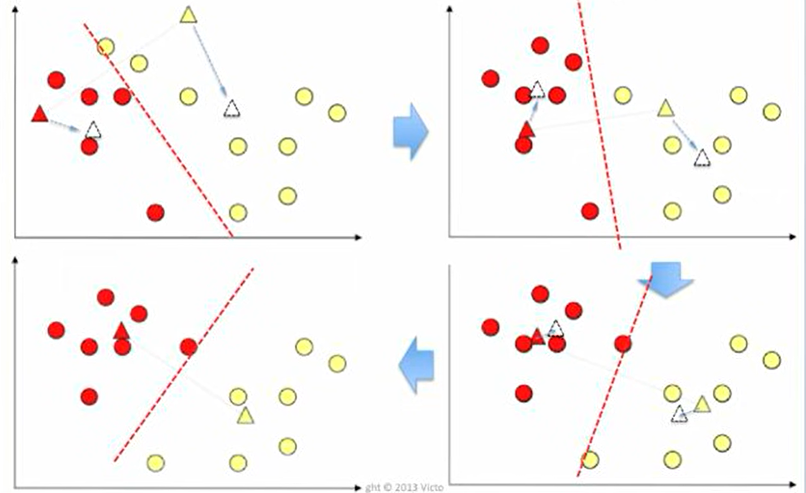
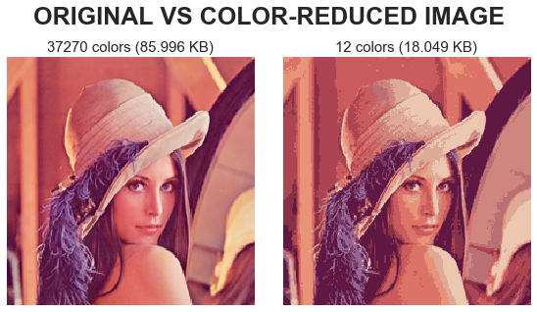
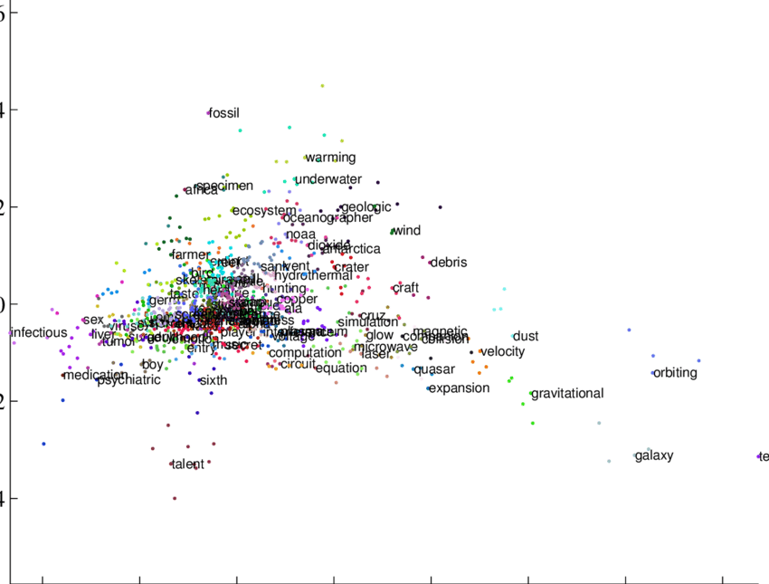
Algorithm
What is K-Means?
1. first assign k centroids randomly in the space, each of the centroids is associated with a cluster
2. For every point, find the nearest* centroid, assign it to the cluster of that centroid
3. Reassign the centroid, such that it is the mean* of all points in its cluster.
4. Repeat 2-3 until cluster reassignments do not change**
K-Means is a clustering algorithm used to split multiple points into k clusters in which their distances* are minimized. K-means is an unsupervised learning algorithm.
* - The method for finding the nearest centroid and the mean of all the points is specific to any given task. In this case, Euclidean distance is used to find the nearest centroid and arithmetic mean is used to find the mean
**- 99% of the times k-means is used, the algorithm is run for a fixed number of iterations or end the algorithm when the change in reassigned values is arbitrarily small
Examples of use
INITIAL STATE
K-means can be used to cluster colors in an image since every color can be represented by a 3-dimensional vector.
Words can be represented as vectors and K-means clustering can be used to determine clusters of similar words in a text. This can be used for summarization algorithms.

